Slide 1
FHIR Overview CCIM
Lloyd McKenzie
Apr. 13, 2018

Slide 2
This presentation
Is licensed for use under the Creative Commons, specifically:
Creative Commons Attribution 3.0 Unported License
(Do with it as you wish, so long as you give credit)

Slide 3

Who am I?
Name: Lloyd McKenzie
Company: Gevity
Background:
One of FHIR’s 3 initial editors
Co-chair FMG & FHIR Infrastructure
Co-chair HL7 Modeling & Methodology
Heavily involved in HL7 and healthcare exchange for last 17 years (v2, v3, CDA, etc.)
lmckenzie@gevityinc.com

Slide 4
Presentation Objectives
Today:
Why FHIR?
The need for FHIR standard
How FHIR is different from other health care IT standards?
HL7, CDA, etc.
FHIR components
resource types, profiles, terminologies, etc.

Slide 5
Presentation Objectives
Tomorrow
FHIR operations
Consent
Error handling
Security
SMART on FHIR
Defining a FHIR interface

Slide 6
WHY FHIR?

Slide 7
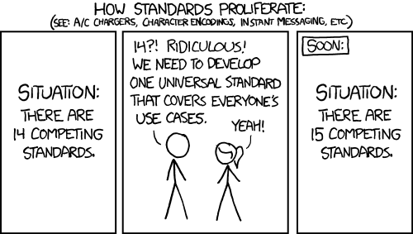
http://xkcd.com/927

Slide 8
Complexity Model
Snomed
HL7 V3
openEHR
WS
CDA
Difficulty (log)
XML
HL7 v2
How?
HTTP / HTML
Text
Semantic Depth

Slide 9
The acronym
F – Fast (to design & to implement)
Relative – No technology can make integration as fast as we’d like
H – Healthcare
That’s why we’re here
I – Interoperable
Ditto
R – Resources
Building blocks – more on these to follow

Slide 10
FHIR – Key differences
Focus on Implementers
Target support for common scenarios
Leverage cross-industry web technologies
Require human readability as base level of interoperability
Make content freely available
Support multiple paradigms & architectures
Demonstrate best practice governance
Notes:
We don’t actually have a formal manifesto, but these are the principles we adhere to.

Slide 11
Example – ISO AD type
isNotOrdered, updateMode, flavorId, nullFlavor, controlAct root & extension, validTime low and high, useable period (GTS – no room on the slide), use
home, primary home, vacation home, workplace, direct, public, bad, physical, postal, temporary, alphabetic, ideographic, syllabic, search, soundex, phonetic
0..* parts, each with:
value, code, code system, code system name, code system version, language, type:
address line, additional locator, unit identifier, unit designator, delivery address line, delivery installation type, delivery installation area, delivery installation qualifier, delivery mode, delivery mode identifier, street address line, building number, building number numeric, building number suffix, street name, street name base, street type, direction, intersection, care of, census tract, country, county or parish, municipality, delimiter, post box, precinct, state or province, postal code, delivery point identifier
Notes:
How many of your systems have user interfaces that support even ¼ of this?

Slide 12
Example – FHIR Address
isNotOrdered, updateMode, flavorId, nullFlavor, controlAct root & extension, validTime low and high, useable period (low, high) (GTS – no room on the slide), use
home, primary home, vacation home, workplace, direct, public, bad, physicalvisit, postal, temporary, alphabetic, ideographic, syllabic, search, soundex, phonetic, old
0..* parts, each with:text
value, code, code system, code system name, code system version, language, type:
address line, additional locator, unit identifier, unit designator, delivery address line, delivery installation type, delivery installation area, delivery installation qualifier, delivery mode, delivery mode identifier, street address line, building number, building number numeric, building number suffix, street name, street name base, street type, direction, intersection, care of, census tract, country, county or parish, municipalitycity, delimiter, post box, precinct, state or province, postalCode, delivery point identifier
Notes:
This is what happens when you apply the 80% . . .

Slide 13
FHIR & Cost of Integration
These factors will drive down the cost of integration and interoperability
Easier to Develop
Easier to Troubleshoot
Easier to Leverage in production
More people to do the work (less expensive consultants)
Competing approaches will have to match the cost, or disappear – effect is already being felt

Slide 14
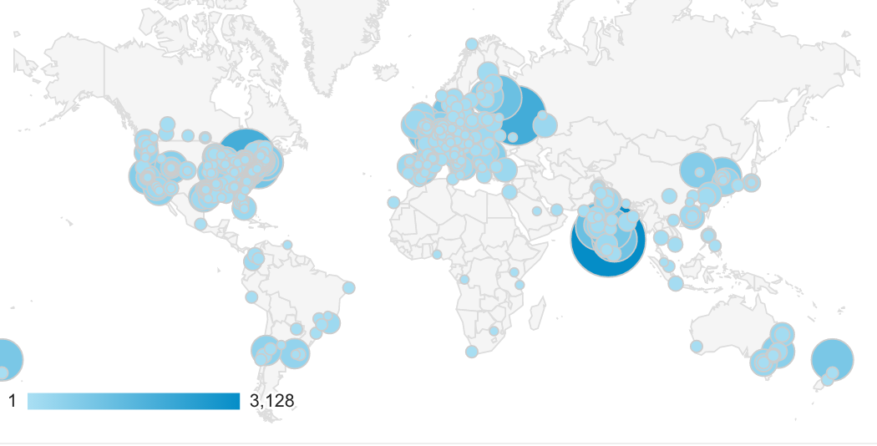
FHIR is world-wide
Systems accessing HAPI server in previous year (as of 2017-05)

Slide 15
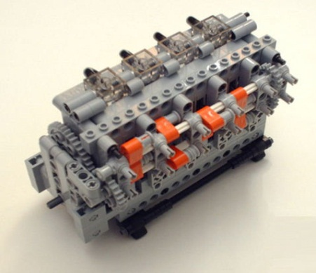
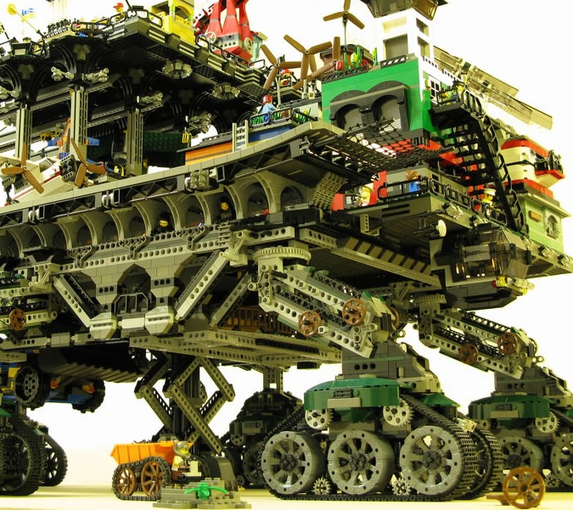

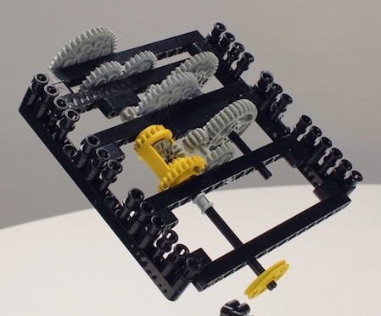
FHIR solutions
Resources
Extensions
Solution
+
=
Notes:
Resources are building blocks, but useful in their own right
Extensions supplement what resource doesn’t cover
Solutions can be simple or complex

Slide 16


Resources
“Resources” are:
Small logically discrete units of exchange
Defined behavior and meaning
Known identity / location
Smallest unit of transaction
“of interest” to healthcare
V2: Sort of like Segments
V3: Sort of like CMETs

Slide 17
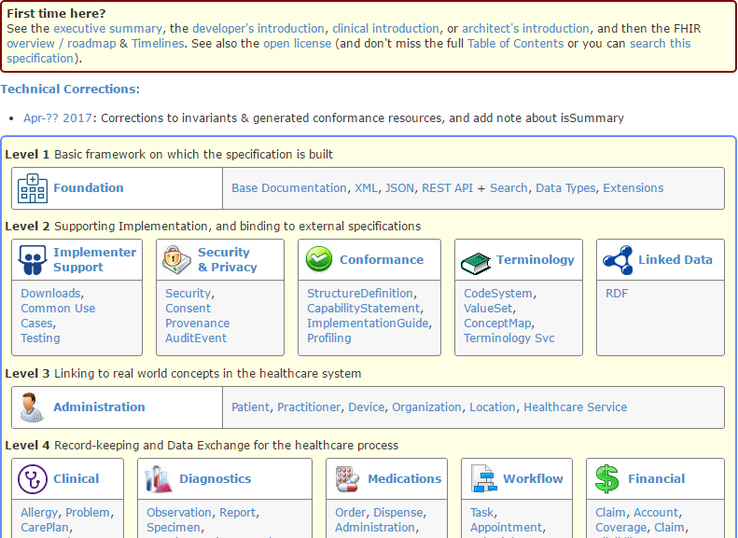
(FHIR home)
hl7.org/fhir
Notes:
Published as HTML
Published using validation process that performs consistency checks – like a software build
Really shouldn’t require much guidance to read, but a few things to call out
Objective of spec is developer can skim and decide in < day

Slide 18
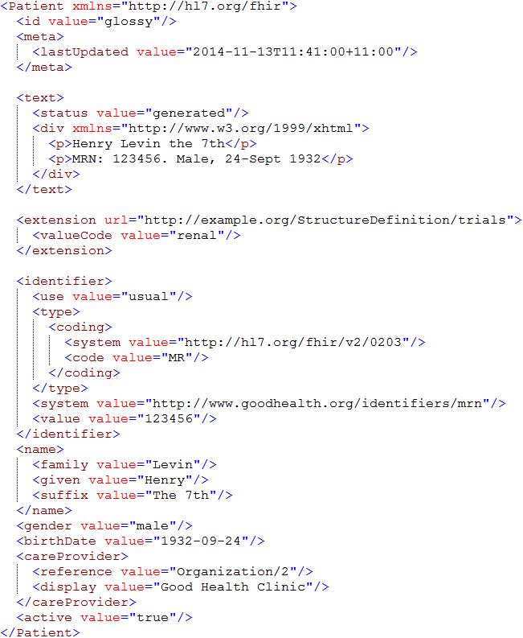
Identity & Metadata
Human Readable Summary
Extension with reference to its definition
Standard Data Content:
MRN
Name
Gender
Date of Birth
Provider

Slide 19
V2 and FHIR
Similarities
FHIR Differences
Built around re-usable “chunks” of data
Strong forward/backward compatibility rules
Extensibility mechanism
Each chunk (resource) is independently addressable
More than messages
Human readable required
Extensions don’t collide, are discoverable
Modern tools/skills
Instances easy to read
Lighter spec
Notes:
Many interface engine vendors working on FHIR support
May make sense for internals of some v2 systems
Add-on interface for mobile, personal health record

Slide 20
V3 and FHIR
Similarities
FHIR Differences
Based on RIM, vocab & ISO Data types foundations
Support XML syntax
Simpler models & syntax (reference model hidden)
Friendly names
Extensibility with discovery
Easy inter-version wire compatibility
Messages, documents, etc. use same syntax
JSON syntax too
Notes:
Lower learning curve
Unlikely to see significant new v3 initiatives in areas that aren’t already committed to it

Slide 21
FHIR and CDA
Similarities
FHIR Differences
Support profiling for specific use-cases
Human readability is minimum for interoperability
APIs, validation tooling, profile tooling
(See v3 similarities on prior slide)
Initial discrete interoperability with the base specification (no templates)
Not restricted to just documents
Implementer tooling generated with spec
(See v3 differences on prior slide)
Notes:
Significant work on CCDA <-> FHIR
Can use both FHIR and CCDA documents with XDS and with MHD

Slide 22
FHIR as a replacement
FHIR has the potential to supplant HL7 v3, CDA and even v2
However
It’s probably not going to do so right away
HL7 will support existing product lines so long as the market needs them
Notes:
Few will throw away their investment in older standards to use FHIR until
The specification has a good track record
It’s clear the new thing provides significant benefits

Slide 23
Infrastructure Resources
Value Sets
Profiles
Code Systems
Capability Statements
Naming Systems
Operation Definitions
Resources like any other
Query
Subscribe
Etc.
Can be packaged into Implementation Guides

Slide 24
FHIR is:
Technology
Spec, reference implementations, test tools
Community
http://chat.fhir.org, forums, connectathons, work groups

Slide 25
Profile-less FHIR
You don’t need profiles to interoperate with FHIR
Resources are “discrete” enough that mechanism to populate most elements is clear
Approach
Populate/consume all elements you know, use HL7 or country-standard extensions for extras
Map to/from “recommended” terminologies as much as possible, populate CodeableConcept.text
Expose capabilities in CapabilityStatement resource
Notes:
With profile, they can interoperate ‘ok’.

Slide 26
Profile Uses
Profiles are still quite useful
Define document and message boundaries
Define extensions
Set interoperability expectations in a particular context
National standards, types of care, business patterns
Clinical practice guidelines / detailed clinical models
Document system capabilities

Slide 27
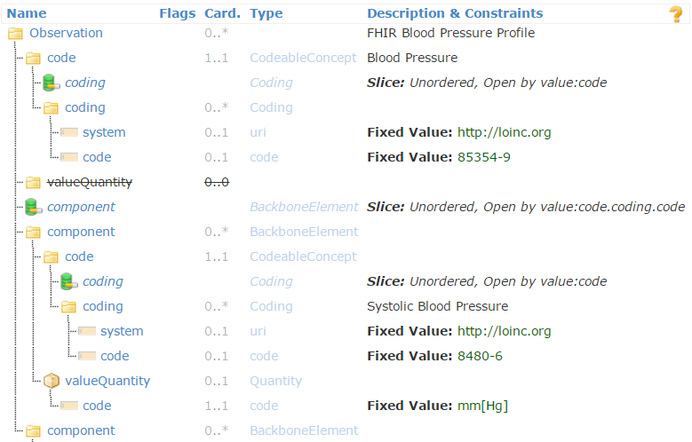
Profiled Observation (Blood Pressure)

Slide 28
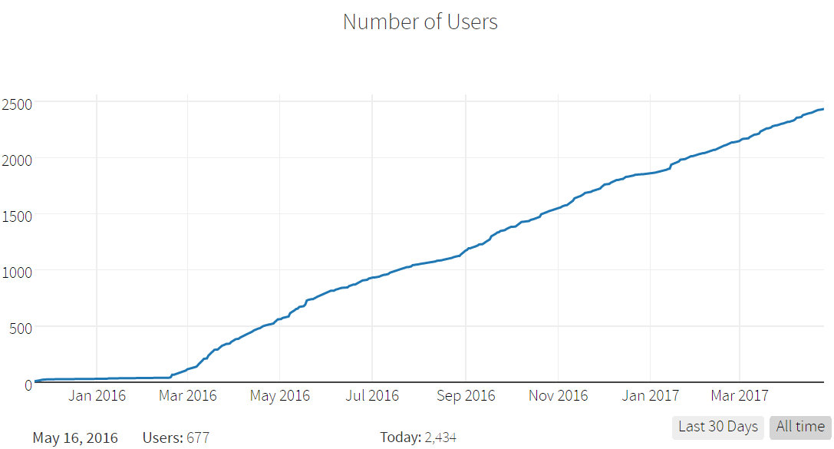
chat.fhir.org growth

Slide 29
FHIR Timeline (planned)
First Draft
1st
STU
~ 2nd
STU
~ 3rd
STU
R4
. . .
2011
2012
2013
2014
2015
2016
2017
2018
2019
2020
Notes:
Note that dates are subject to change based on resources and the standards process

Slide 30

Questions?
http://hl7.org/fhir lmckenzie@gevityinc.com

